Slide 1


HUM 102 Report Writing Skills
Lecture 06

Slide 2
Previous Lecture
Discussions
Findings
Conclusions
Recommendations
Appendices

Slide 3

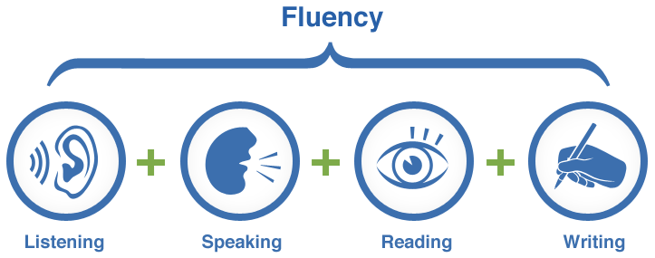
Four Skills of Language Learning

Slide 4
Four Skills of Language Learning

Slide 5
What is Technical Writing?
“Involving special knowledge, language, etc., that is used or understood by experts but usually not by others”
(Merriam-Webster Dictionary, 2015)
“Relating to the knowledge, machines or methods used in science and industry”
(Cambridge Dictionary, 2015)

Slide 6
What is Technical Writing?
Technical writing communicates specific and factual information to a defined audience for a defined purpose.
Specific Factual Information
Defined Audience
Defined Purpose

Slide 7

Technical
Knowledge
Written Communication
What is Technical Writing?

Slide 8
What is Technical Writing?
Writing
Technical Writing
Professional Writing
Business Writing
Occupational Writing
“Technical writing conveys specific information about a technical subject to a specific audience for a specific purpose… The words and graphics of technical writing are meant to be practical: that is, to communicate a body of factual information that will help an audience understand a subject or carry out a task.”
-Michael H. Markel

Slide 9

Origin
Recorded history: Da Vinci, Copernicus, Galileo
Increasing literacy: need of explaining mechanical processes
Second World War: development of weapons
Computer revolution: communication networks

Slide 10
Conclusions
Types of Report
Informal Report and its Types
Formal Report and its Types
Additional Forms of Reports

